Slide 1
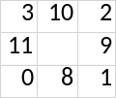
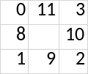
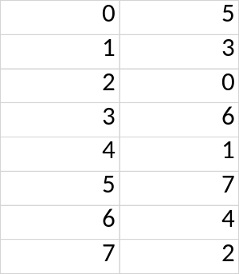


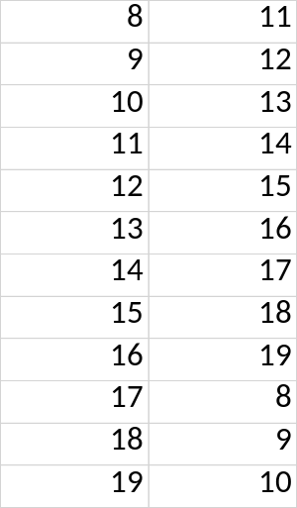


U
Visual:
Indexes: 0-7
Old Array:
New Array:
Old -> New
=>
Part 1: Rotation
Old -> New
Indexes: 8-19
Old Array:
New Array:
Part 2: Shift

Slide 2
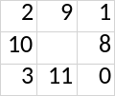
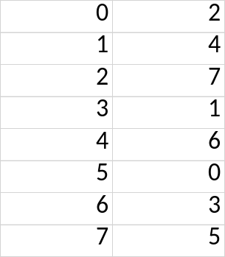

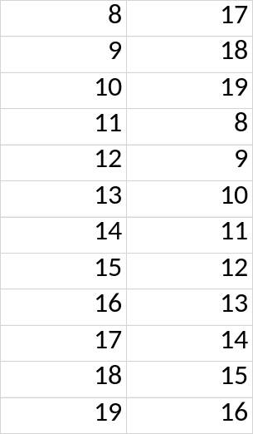

U’
Visual:
Indexes: 0-7
Old Array:
New Array:
Old -> New
=>
Part 1: Rotation
Old -> New
Indexes: 8-19
Old Array:
New Array:
Part 2: Shift

